Slide 1


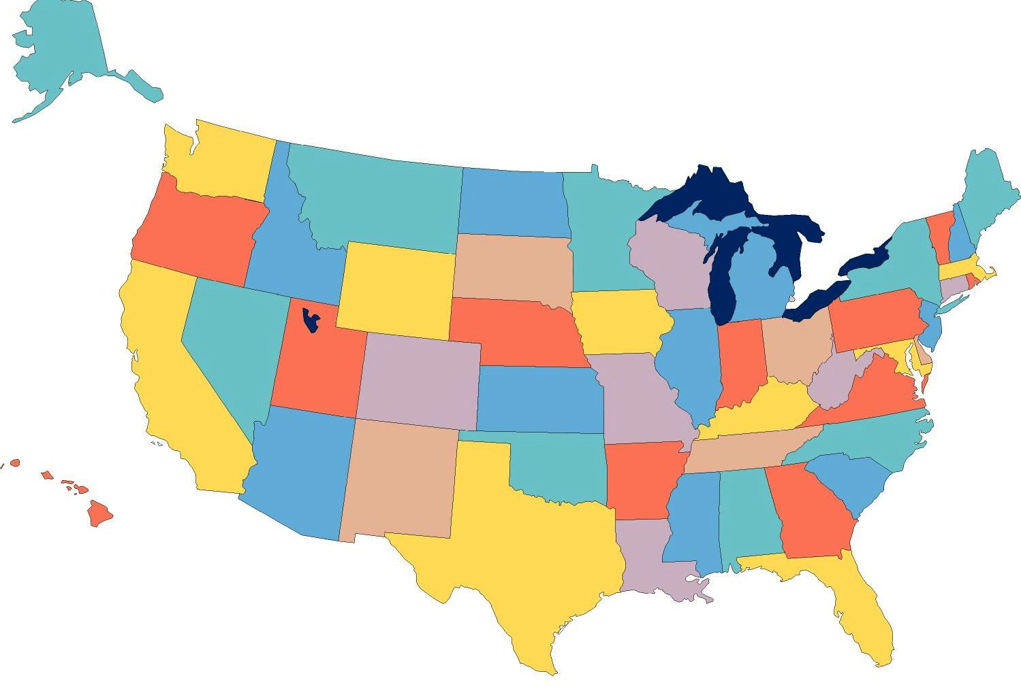


Employment First:
A National Update
David Hoff
Institute for Community Inclusion
University of Massachusetts, Boston
david.hoff@umb.edu - 617-287-4308
www.communityinclusion.org

Slide 2

Employment First: What Is It?
General theme:
Employment in the community is the first/primary service option for individuals with disabilities
APSE Statement on Employment First
Employment in the general workforce is the first and preferred outcome in the provision of publicly funded services for all working age citizens with disabilities, regardless of level of disability.

Slide 3

Employment First: Why it’s different
Clear state policy: employment as first priority
Broadly focused on all aspects of system: funding, data, quality assurance, polices and procedures, training/staff development, procurement, service providers, etc.
While it may begin in the grassroots, ultimately must be adopted and implemented by the system
Not focused on eliminating facility-based services
Other differences

Slide 4



Why Employment First is Important
Sets a clear direction from a
policy and practice perspective

Slide 5


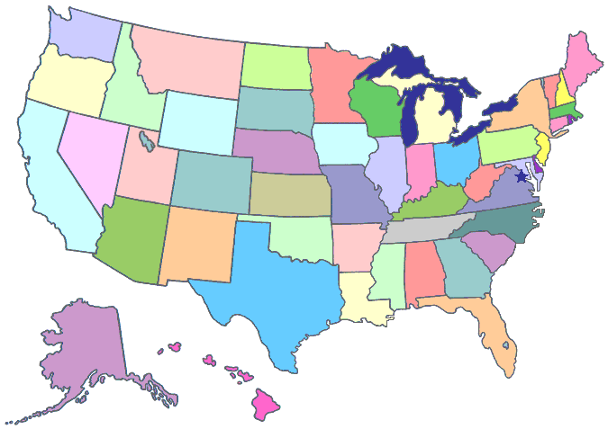
Employment First:
Why It’s
Important
Promoting a national conversation on employment
Is spurring a national movement
Spreading across the country

Slide 6

In many cases, efforts have been specifically dubbed
“Employment First”
In others, Employment First as a concept has been embraced, without using specific term
Calling something “Employment First” doesn’t necessarily mean it is
“Employment First”:
Is use of the term important?

Slide 7



Employment First: A Brief History
Pennsylvania: First state to have policy
that prioritized community employment
for individuals with ID/DD (1990)
  “The Office of Mental Retardation believes that persons with mental retardation should have access to community employment opportunities and that employment opportunities should always be considered before any less, more restrictive programs. “
Variety of activities and efforts in other states along the same theme
Tennessee: First state to use term “Employment First” (2003)

Slide 8


Employment First 2012
30+ states have some type of “Employment First” movement
  About 3/4 of efforts are directed by state policy units or are legislatively based
  About 1/4 of efforts are grassroots based – i.e., outsiders working to influence state policy and practice
At least 20 states have official Employment First
legislation and/or polices

Slide 9

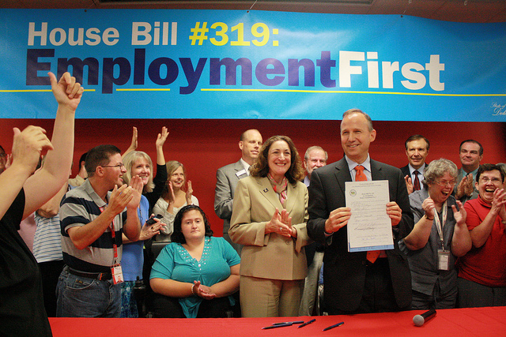
Employment First Policies:
A Closer Look
20 States with a policy:
AR, CA, CO, CT, DE, KS, LA, MD, MA, ME, MO, NJ, OH, OK, OR, PA, TN, UT, VA, WA
7 have passed legislation (CA, DE, KS, PA, VA, UT, WA)
Remainder are Executive Orders, policy directives, etc.
7 polices are cross-disability; remainder ID/DD

Slide 10




Employment First Policies: Examples
Louisiana Office of Citizens with Developmental Disabilities
Employment will be the primary outcome for all persons receiving OCDD services of working age. Employment is characterized by typical jobs with competitive compensation that are fully integrated into the workplace.
Massachusetts Department of Developmental Disabilities
This policy, known as the “Employment First” policy, establishes that
for working age adults served by the Massachusetts Department of Developmental Services, integrated, individual employment is the preferred service option and optimal outcome.
Washington State – Working Adult Policy
Supports to pursue and maintain gainful employment in integrated settings in the community shall be the primary service option for working age adults.

Slide 11


Excerpt from Kansas Employment First Legislation
Signed into Law May 11, 2011
It is hereby declared to be the policy of the state of Kansas that competitive and integrated employment shall be considered its first option when serving persons with disabilities who are of working age to obtain employment.
This policy applies to programs and services that provide services and support to help obtain employment for persons with disabilities.
All state agencies shall follow this policy and ensure that it is effectively implemented in their programs and services.

Slide 12


Excerpt from Governor’s Executive Order Establishing the Arkansas Employment First Initiative
October 21, 2010
State agencies, whose missions include service to individuals with disabilities, shall develop and implement Employment First policies and procedures that prioritize employment as the preferred service option for individuals with disabilities

Slide 13

Employment First:
Should every state be involved?
Non-involvement in Employment First does not necessarily mean a state is not focused on employment
Several states with relatively strong ID/DD integrated employment outcomes have not been identified with Employment First (e.g., VT, NH)
However, strong and comprehensive Employment First initiatives can be a catalyst for improvement

Slide 14


Plusses & Minuses
Issuing an Employment First Policy
Policy Positives:
  Easier to create and issue
  Easier to include strong, specific language
Policy Negatives:
  Easy to rescind (change in administration, public pressure on administrator, etc.)
  Potentially limited broad-based support

Slide 15


Plusses & Minuses:
Passing Employment First Legislation
Legislation Positives:
  Rule of law
  Broad political support
  Difficult to rescind – requires legislative action
Legislation Negatives:
  Takes lots of work to get passed: legislative advocacy, coalition building, etc.
  Legislative language may not be as strong as policy, as a result of political compromises to get legislation passed

Slide 16


Does Employment First Legislation Make Sense for Your State?
What is the role of legislation in how your state systems operate?
What will be the benefit of legislation vs. policy?
How long will it take to get legislation passed?

Slide 17

The Challenges of Employment First
Clarity, substance, and scope of efforts vary
  Some include group employment, sub-minimum wage
Overly identified with ID/DD
In danger of becoming just the latest fad and “buzz word”
  Already being used where focus is not on employment as first priority, or simply to promote good employment strategies not focused on policy and systems change
It’s easier to change policy than practice
  Policy changes don’t necessarily lead to practice changes and increases in employment

Slide 18

Employment First Policies:
Relation to Outcomes
States with policies vary extensively in terms of progress and outcomes
Partially due to timing: many policies are only a year or so old
Others: lacking in commitment/follow-through, inability to abandon old models

Slide 19





Going Back in Time
The Roots of Our Employment System

Slide 20


1601
Elizabethan
Poor Laws
Enacted to aid the “deserving poor, orphaned, and crippled”.
Persons with disabilities labeled as “helpless poor” entitled to money and food from society, paid for through a tax on land owners

Slide 21


1750
Act Passed by New England Colony of Connecticut
Persons with disabilities should be cared for by their closest relative. If such a person had no relative then the town or the colony itself took direct responsibility.

Slide 22

The Medical Model:
Disability is a
condition to be
treated or cured by professionals

Slide 23

Medical Model
Policies and Practices
People with disabilities are worthy poor entitled to public support
Policies provide that people with disabilities be served by middle class workers on whom they rely to receive services
People with disabilities are, by definition, dependent on society and considered an economic burden
People with disabilities are expected to rely on public supports for basic needs
Access to services are determined by gate keeping professionals on whom people with disabilities rely
High unemployment and poverty rates are explained primarily as result of disability rather than social causes such as discrimination and lack of opportunity
Economic outputs are perceived by society as “services” in which nothing is expected in return, vs. investment in which a return on investment is expected

Slide 24

Examples of Medical Model
Day habilitation & sheltered workshops
Any service that segregates
Funding system based on hours of service not outcomes
Presumption that people with disabilities need day service forever
Disability = can’t work
Working results in loss of health benefits
Work as an income supplement
People with disabilities need to prove they are “work ready”
Staff: caretakers and primary means of assistance
Use of Medicaid as primary funding mechanism for employment supports

Slide 25

Emerged and evolved over last 30 to 40 years
Defines disability as a component of diverse tapestry of society
Problems faced by people with disabilities arise primarily from social and societal forces rather than individual’s disability
Access to full society resources, rather than individual “repair”, are key to success

Slide 26

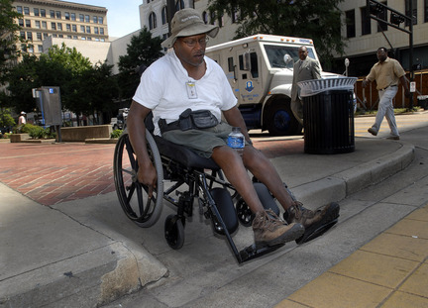
Example of Social Model

Slide 27
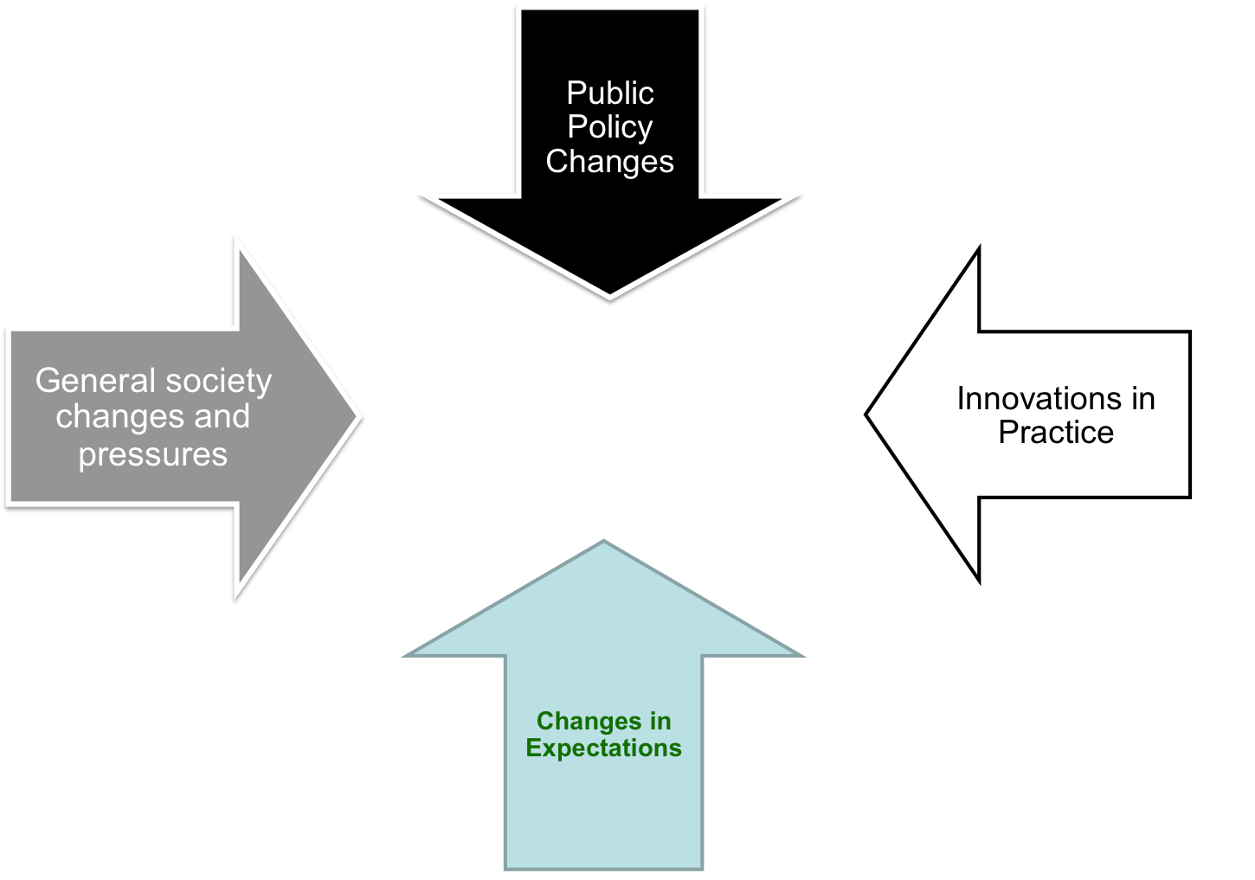

Moving to a Social Model of Employment
Movement to Increase Community Employment

Slide 28

What the Social Model means in terms of employment?
Similar employment expectations as other members of society
Employment in typical settings integrated within general workforce is expected
Employer practices and employment settings are modified to accommodate needs of workers with disabilities
Services provided to individuals with disabilities are considered an investment to help them succeed, not caretaking
Maximize use of natural/community supports
  Reliance on paid supports only as necessary
Primary role of paid supports is to facilitate integration into mainstream society

Slide 29

Individuals with even “most severe” disabilities working successfully
Disability no longer seen as insurmountable barrier to employment
Expectations are changing
  Individuals and families
  Public systems & policymakers
  Society

Slide 30

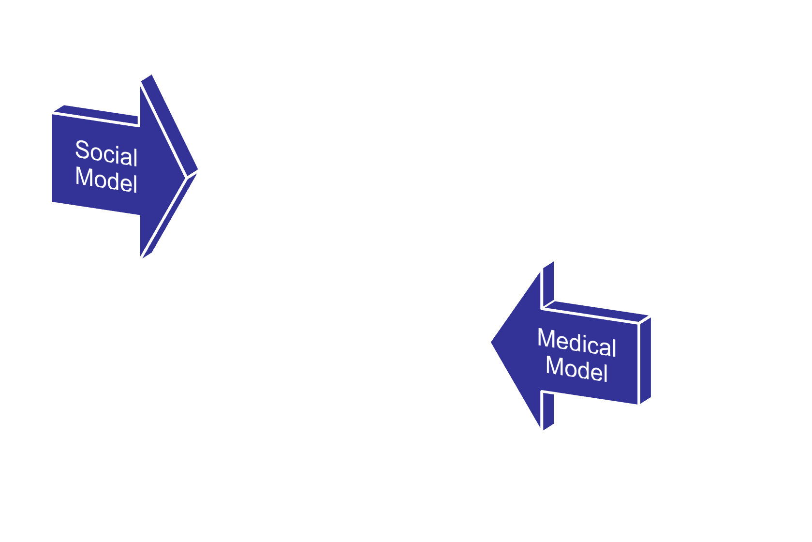
But the Medical Model is Still Very Much with Us
Individuals with Disabilities
Families
Service Providers

Slide 31



Social Security:
Primary Example of Transformation to Social Model from Medical Model

Slide 32
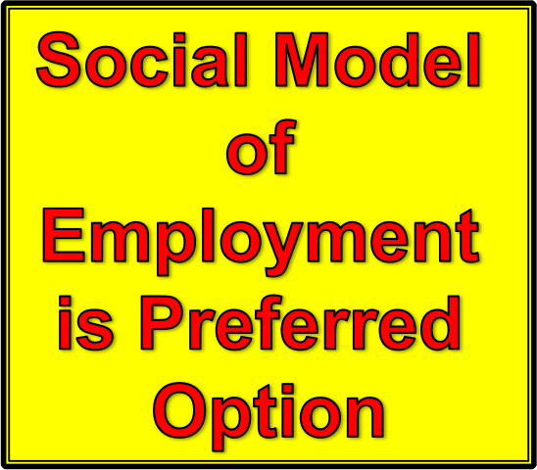
Employment First Sends a Clear Message
Social Model

Slide 33


"The world is full of good intentions,
and I never met a nonprofit whose
mission statement I didn't like.
But I have not met all that many who could present some evidence of specific accomplishments that would lead
in the direction of
fulfilling their mission."
Norton Kiritz
Founder, The Grantsmanship Center
Notes:
EXPLAIN QUOTE WITH NEXT SLIDE

Slide 34


The benefit of an Employment First policy is that it sets a clear direction in terms of priorities and use of resources.
But it will only be successful if the vision of Employment First is integrated within the wide range of policies, procedures, and processes that impact employment of people with disabilities.

Slide 35




SELN:
What We’ve Learned
Systems change must fit within overall
culture of state
Systems change requires both:
  big picture perspective and leadership
  willingness to get into “nitty gritty” policy and practice details
Slow and steady wins the race
It’s not one thing, it’s a lot of things
Notes:
SLOW
- Big picture – clear vision is important a la Employment First
- Any well run organization does a lot of things well

Slide 36


Making Employment First a Reality:
Public System Basics
Service provider contracts awarded to organizations that embrace Employment First principles, in conjunction with reduced reliance on contractors that reinforce traditional service approaches
Service contracts clearly specify expectations regarding service provision and outcomes in line with Employment First principles
Standards for employment in the community are integrated within program monitoring and quality assurance processes
Funding mechanisms provide incentives for employment
Funding policies support shifting of resources to community employment, and reduced funding of facility based services

Slide 37

Making Employment First a Reality:
Systems & Service Providers
Clear agency policy, well understood by all staff: employment in the community is the first priority in terms of services
Policies & procedures presume that individuals can work successfully in the community
  Criteria & professional judgments regarding work readiness and earning the right to a job in the community are avoided
Consideration of employment mandated part of any type of individual planning for persons of working age
  Follows tenants of person-centered planning – “nothing about me without me”
  Documentation for non-consideration of employment is required
Clear policy that experiential assessments (e.g., situational assessments) must be conducted in community
Data system in place that tracks employment outcomes

Slide 38

Employment in the community cannot be viewed as an
“add on” or something extra.
It must be viewed by everyone as a core component of the service delivery system.
Notes:
SLOW

Slide 39

“If you can’t
measure it,
I’m not interested.”
Laurence J. Peter

Slide 40



Making System Accountable
Data system in place that tracks outcomes across systems
Publicly available employment
“report card”
  System and individual provider

Slide 41

Turning Employment First Into Reality:
Polices & Practices that Presume Employability
Eliminate criteria and professional judgments regarding work “readiness”
Consideration of employment mandated part of any type of individual planning for persons of working age
  Including school age
Documentation for non-consideration of employment is required
Decision to not consider employment is re-visited on regular basis

Slide 42


Employment First:
Contracting & Program Monitoring
Service provider contracts awarded to organizations that embrace Employment First principles
Reduced reliance on contractors that reinforce traditional service approaches
Service contracts clearly specify expectations regarding service provision and outcomes in line with Employment First principles
Standards for employment in the community are integrated within program monitoring and quality assurance processes

Slide 43


- Pay for what you want.
- Don’t pay for what you
don’t want.
Determine current breakdown of funding: community employment, facility, non-employment
Develop rate structures that provide incentives for employment
Develop funding policies that support shifting of resources to community employment & reduced funding of facility based/non-employment services

Slide 44


Funding: Basic Strategies
Take current funding and use it differently
Expand sources of funding
  - Public Vocational
  Rehabilitation
  - Ticket to Work
  - SSA Work Incentives
  - Workforce Development
  - State line items
  - Others

Slide 45


If you’re dealing with funding,
it means dealing with Medicaid
In most cases, vast majority of funding for services is Medicaid
CMS is pushing community employment
  E.G. – guidance on waiver definitions
New options under Deficit Reduction Act & Affordable Care Act
  E.G. 1915 (i); 1915 (k)

Slide 46



Public VR & Employment First
Need to bring Vocational Rehabilitation to the table
Clearly communicate principles of Employment First, which align with VR goals

Slide 47


VR Eligibility Criteria
Physical or mental impairment that results
in substantial impediment to employment
Individual requires VR services to prepare for, secure, retain, or regain employment
A presumption that individual can benefit in terms of an employment outcome from the provision of VR service
Individuals on SSI and SSDI are presumed eligible for VR services, if they want to go to work

Slide 48

VR Presumption of Employability
Person is presumed to be able to benefit in terms of employment outcome, unless VR program demonstrates based on “clear & convincing evidence” (highest standard in civil law) that applicant is incapable of benefiting in terms of employment outcome from VR services due to severity of disability
Before such a determination is made, VR must conduct assessment of individual’s capacity to perform in realistic work situations

Slide 49

Assessments should be in community-based employment settings
No assessments using facility-based programs
VR Assessment and
Employment First

Slide 50

Support by VR for
Employment First
Clear structure for integration of VR within service delivery
Enforcement of eligibility criteria, and presumption of employability
No referrals to facility-based services
Support for transition

Slide 51



Employment First & Transition Policies
Prohibit use of facility-based services during transition
Allow facility-based services as outcome as exception requiring high administrative approval
Employment addressed as a core element of IEP starting no later than age 14
Require high level of documentation if decision is made not to pursue employment
Effective Indicator 14 measurement and monitoring

Slide 52




Employment First & Transition Practices
Presume that all students can succeed in employment
Support typical student work experiences
  Jobs after school and weekends; summer jobs
  No more job “programs”
Integrate students into school-to-career opportunities available to all students
  Internships, job shadowing, etc.
Link with vocational education programs

Slide 53

Employment First: Where are we headed?
People with significant disabilities fully accepted and supported in the workplace in typical jobs
People with disabilities expecting to go to work
Major evolution of service system
  Paid supports available and provided on as-need basis
The end of the “guarantee” of a 9 to 3 day program
People with disabilities increasingly part of economic mainstream
People with disabilities making full use of their skills, gifts, and talents

Slide 54



“Before the enormity of the Sphinx, they would stand and talk of the desert heart.”
- George Santayana

Slide 55
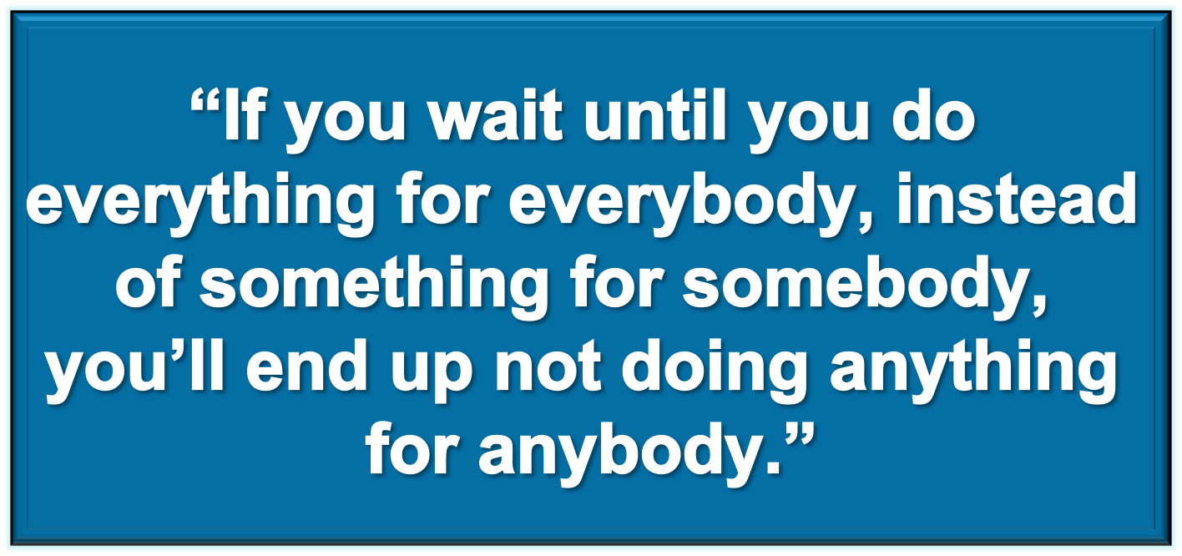
Malcolm Bane
Notes:
SLOW

Slide 56


“We’re Far Too Patient With The Passage Of Time For People With Disabilities. . .
Time Is As Precious For A Person With A Disability
As It Is For All Of Us.”
- Gerry Provencal

